Slide 1

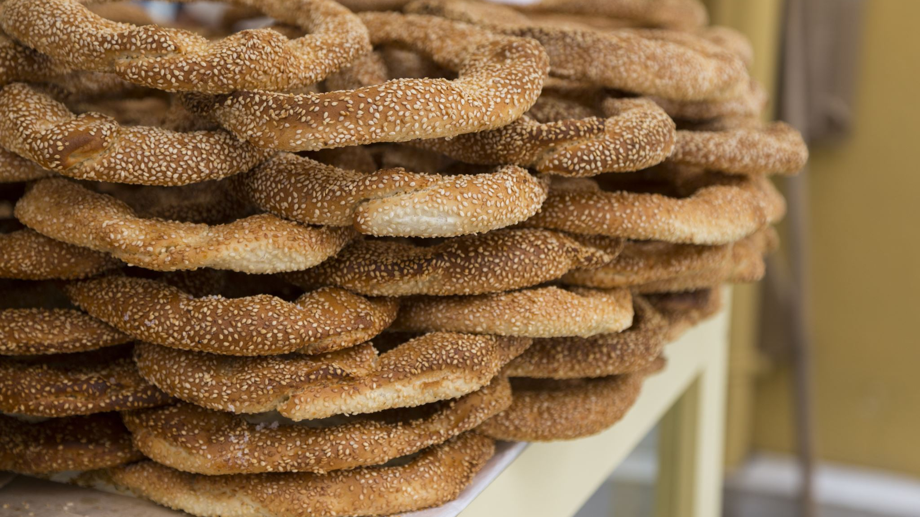
All Star Bagels
By: Cameron Webb, Clark Lewis, Drew Elliott, Ethan Tice

Slide 2
Introduction
Introduction
Background – Purpose – Mission Statement
Bake Waste Recommendations and Graphs
Weather Recommendations and Graphs
Overtime Hours
Conclusion/Questions

Slide 3
Background – Purpose – Mission Statement
Background
Purpose
  Efficiency
    Variety
    Baker
  Weather Patterns
  Overtime Hours
Make more strategic decisions using business analytics to increase profitability and reduce waste

Slide 4
Bake Waste Recommendation
Plain bagel efficiency
Reduce pumpernickel bagels
Training to reduce employee wasterate%
Avoid null bakers

Slide 5
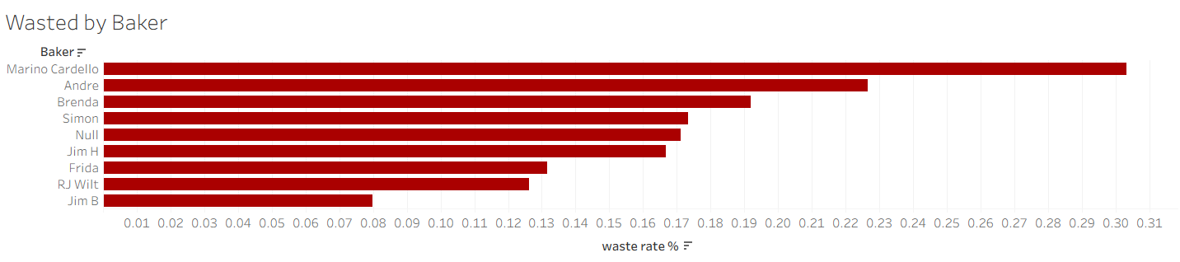
Bake Waste Employee Visualization

Slide 6
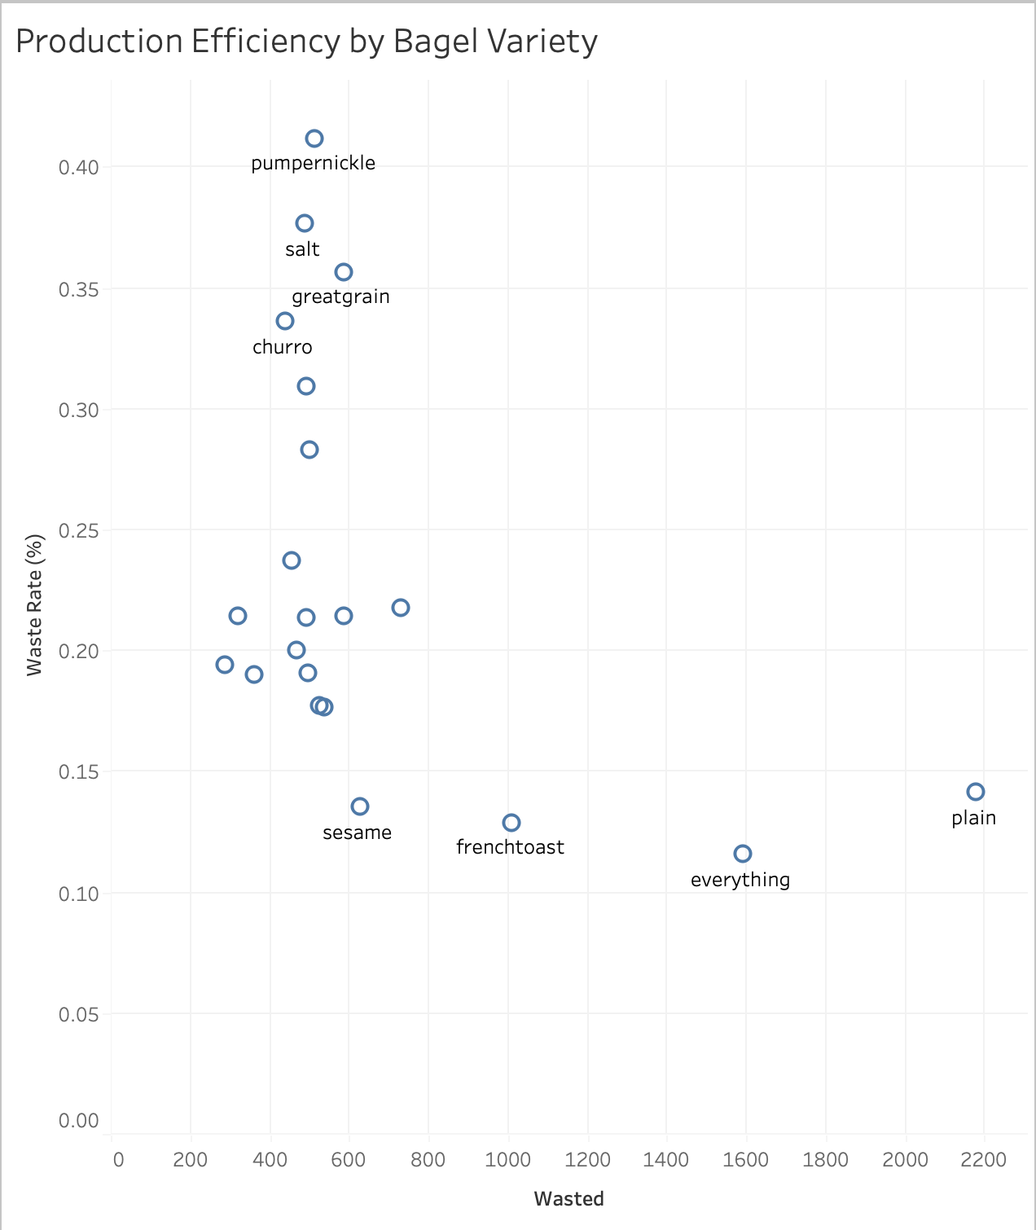
Production Efficiency by Bagel Variety

Slide 7
Weather Patterns - Recommendations
Predictive Ordering
More than just bagel waste
Burrito in rainier months
Hot Drinks in Winter
Smoothies and Lunch Items in Summer

Slide 8
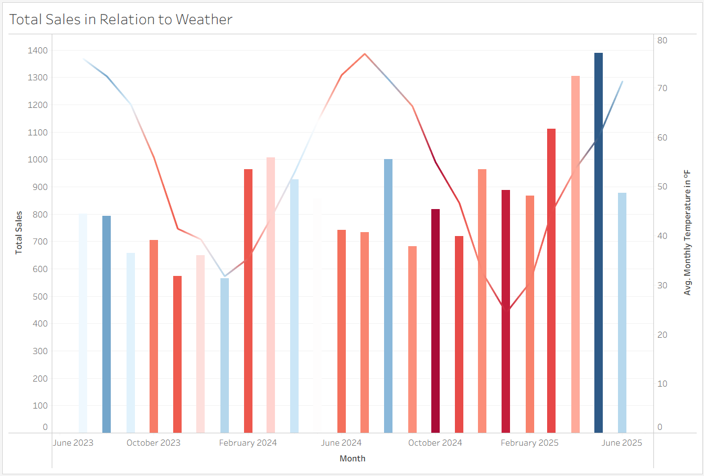
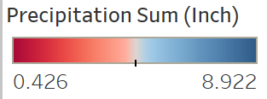
Burritos

Slide 9
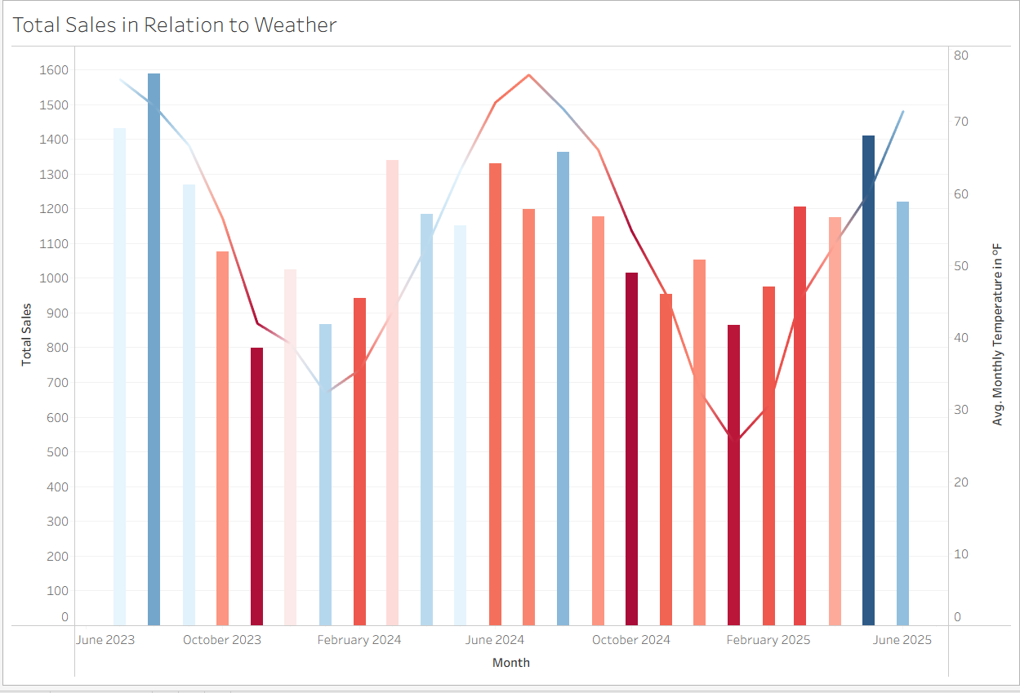
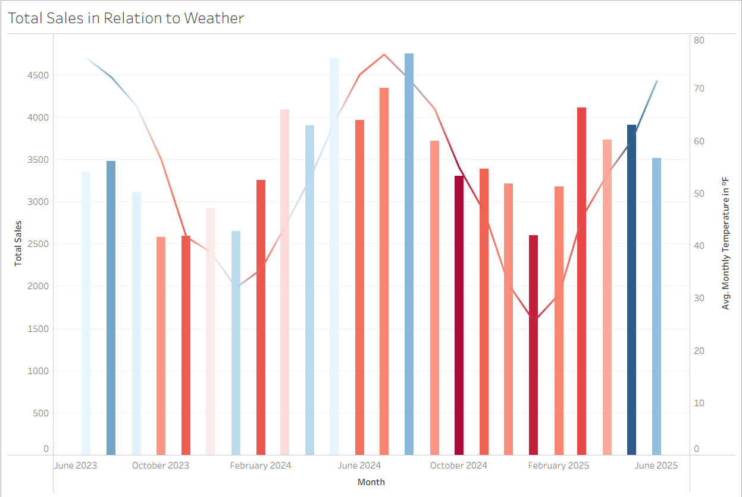
Lunch Items
Smoothie Items

Slide 10
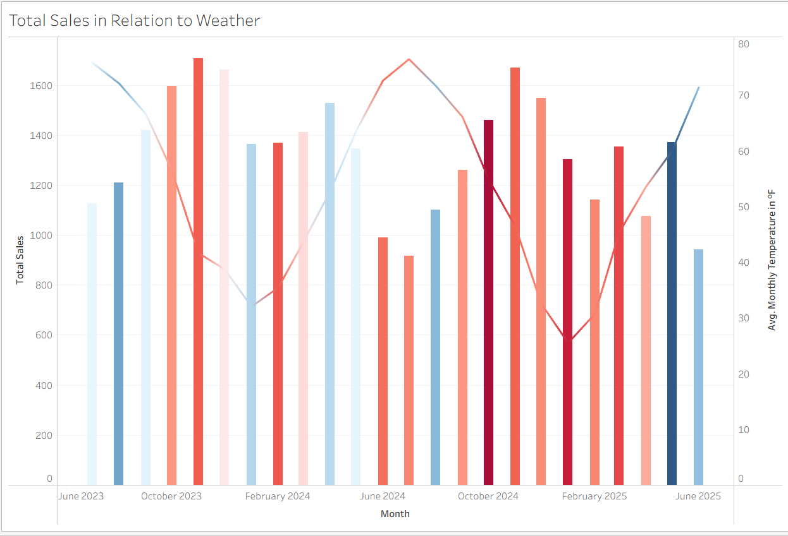
Hot Drinks

Slide 11
Scheduling Recommendations
Policy adjustments
Scheduling strategy

Slide 12
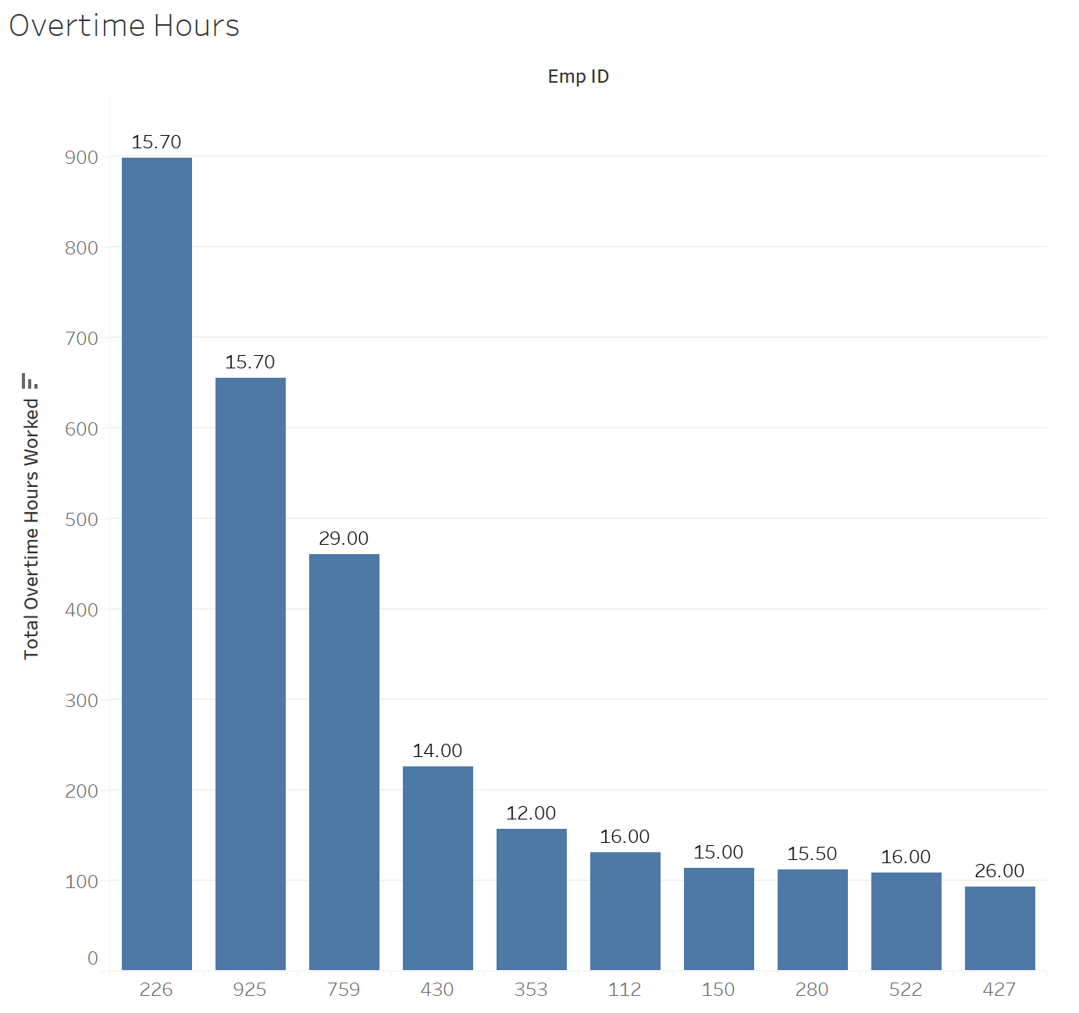
Overtime Hours
What are we looking at?
How did we get here?
Results
  4,074 total OT hours
  Top 10 = $52,453
Limitations
  Late Starts and Early Ends (1,830 h)
  Unscheduled shifts (1,966 h)
  Net +136

Slide 13

Questions

